Slide 1
Module 2: Designing Your Environment
Notes:
Welcome to Module 2: Designing Your Environment.
This module guides you through how architects design their Amazon Web Services, or AWS, environments. It also establishes guidelines and patterns for selecting AWS Regions, Availability Zones, Multi-Accounts, Multi-VPCs, and subnet structures. These concepts are conveyed through a mixture of recommendations, best practices, design patterns, and questions meant to be used by architects to determine the full requirements of their solution.

Slide 2
What’s In This Module?
Part 1: Choosing a Region
Part 2: Selecting Availability Zones
Part 3: Virtual Private Cloud (VPC)
Part 4: Dividing VPCs and Subnets
Part 5: Default VPCs and Default Subnets
Part 6: Controlling VPC Traffic
Part 7: Connecting Multiple VPCs
Part 8: Integrating On-Premises Components
Part 9: VPC Best Practices
Exercise: Improve this Architecture
Notes:
In Parts 1, 2, and 3, you will look at choosing a Region, selecting an Availability Zone, and Virtual Private Cloud (or VPC). In parts 4 and 5, you will gain a further understanding of what VPCs and subnets are, including default VPCs and default subnets. Part 6 reviews controlling VPC traffic, Part 7 discusses connecting multiple VPCs, and Part 8 reveals how to integrate on-premises components. The module wraps up in Part 9, with a review of VPC best practices and an exercise to improve this architecture.

Slide 3
Module Objectives
Upon completion of this module, you will be able to:
Discuss how to design secure, reliable, high performing, and cost efficient systems.
Highlight principles to consider when either migrating existing applications to AWS or designing new applications for the cloud.
Identify the design patterns and architectural options that can be applied in a wide variety of use cases.
Notes:
Upon completing this module, you will be able to:
Discuss how to design systems that are secure, reliable, high performing, and cost efficient.
Highlight principles to consider when either migrating existing applications to AWS or designing new applications for the cloud.
Identify the design patterns and architectural options that can be applied in a wide variety of use cases.
These recommendations and best practices are based on the wealth of experience and knowledge that the AWS team of experts have put together based on work with numerous customers. They are not meant to be hard and fast rules unless specified as a rule. It is about making sure that the architect can evaluate the options for structuring systems and providing questions to ask during a design review to ensure that all decisions are able to be justified and supported with a reason (Cost, Security, Governance, or other driver).

Slide 4
Part 1: How to Choose a Region.
Notes:
Introducing Part 1: How to Choose a Region.

Slide 5
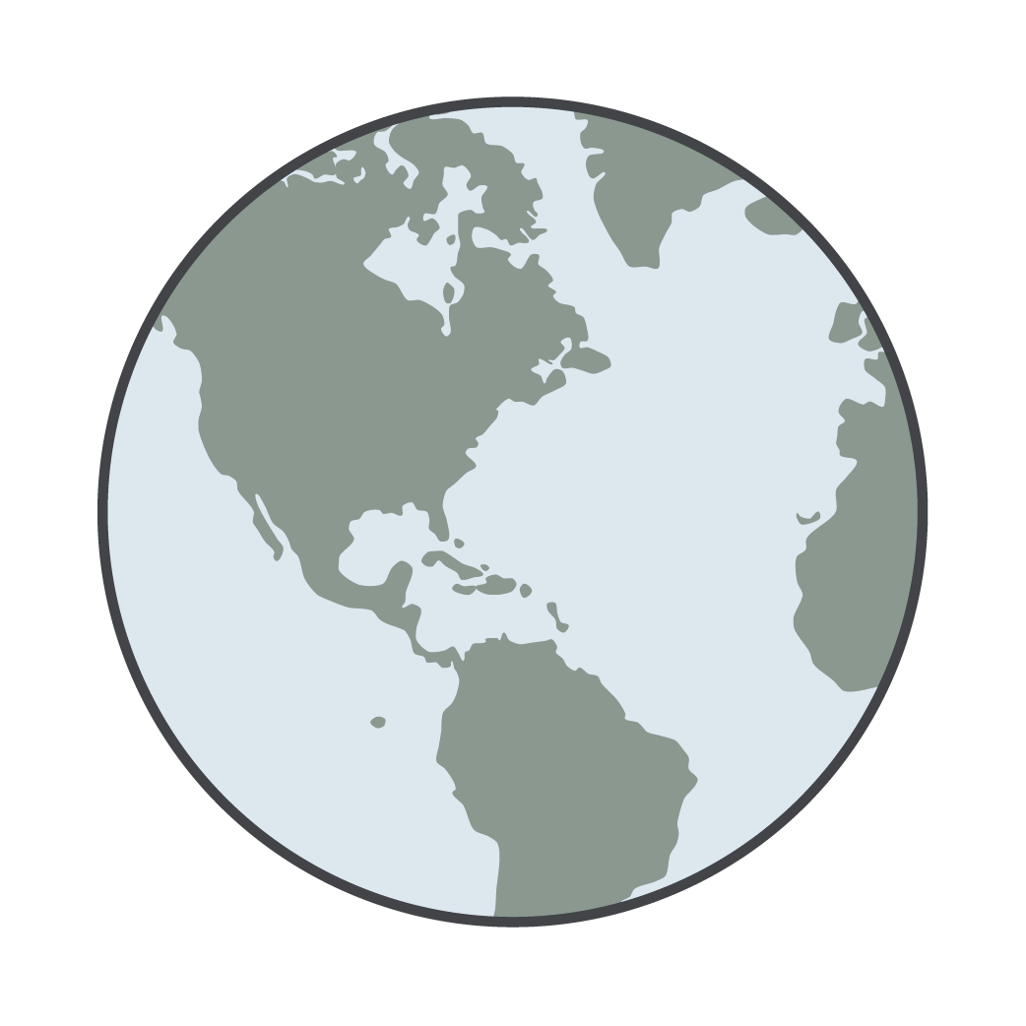
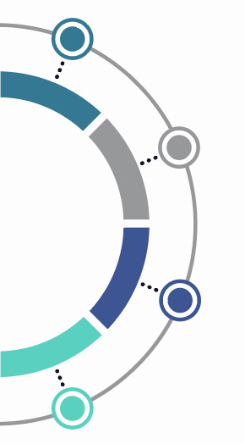
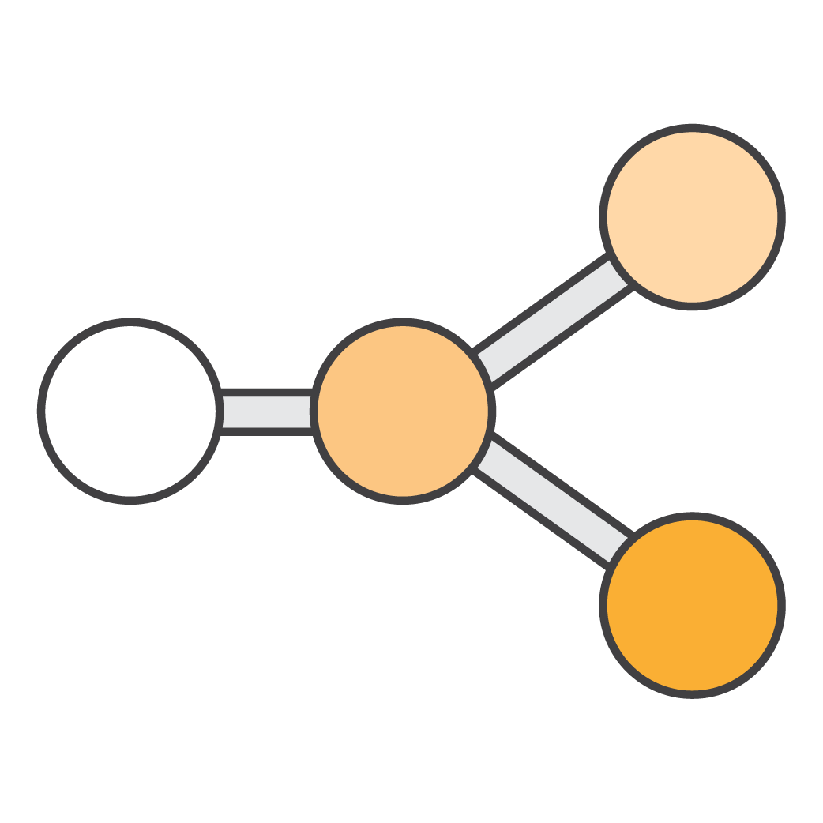
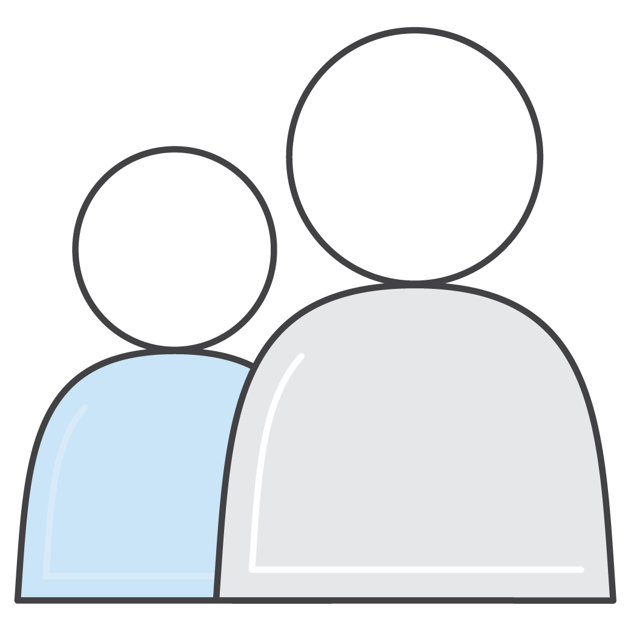
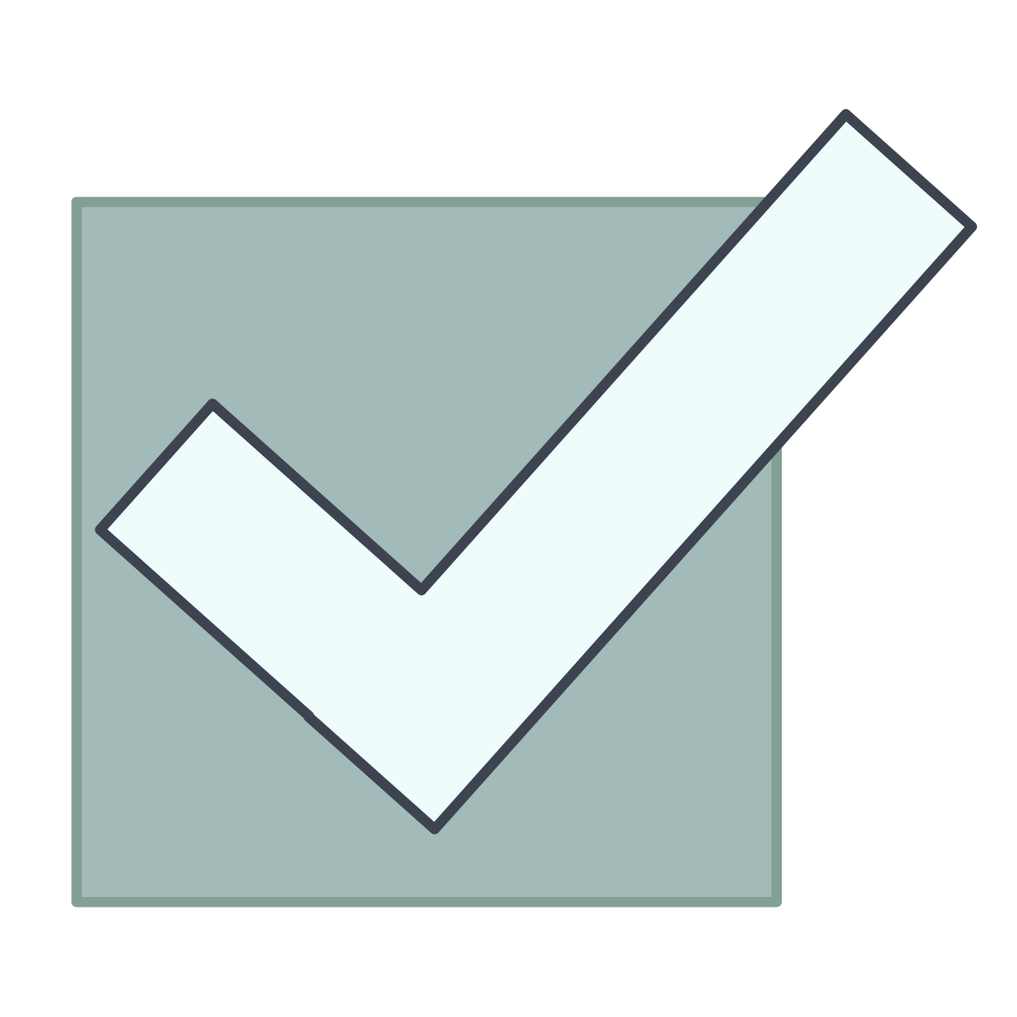
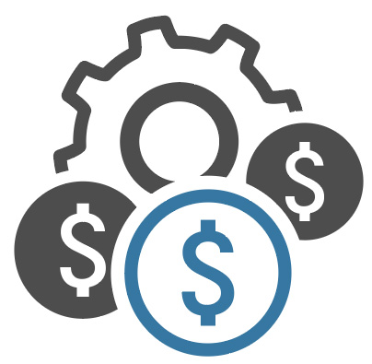
How to Choose a Region?
Data sovereignty and compliance
$
$
Proximity of users to data
$
Availability of services and features
Cost effectiveness
Notes:
Let’s discover how to choose a Region.
Choosing a region involves four main considerations:
Data sovereignty and compliance
Proximity of users to the data
Service and feature availability
And cost effectiveness
Let’s take a look at each of these in greater detail.

Slide 6

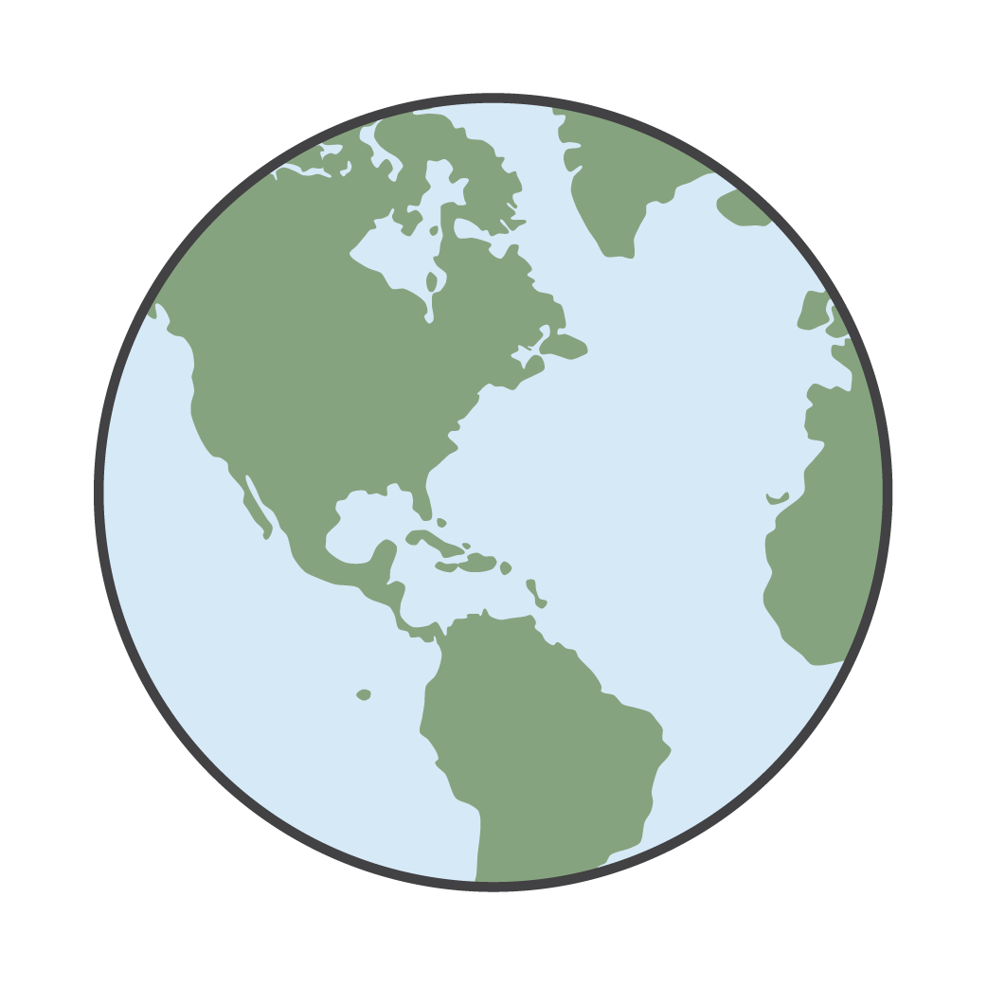
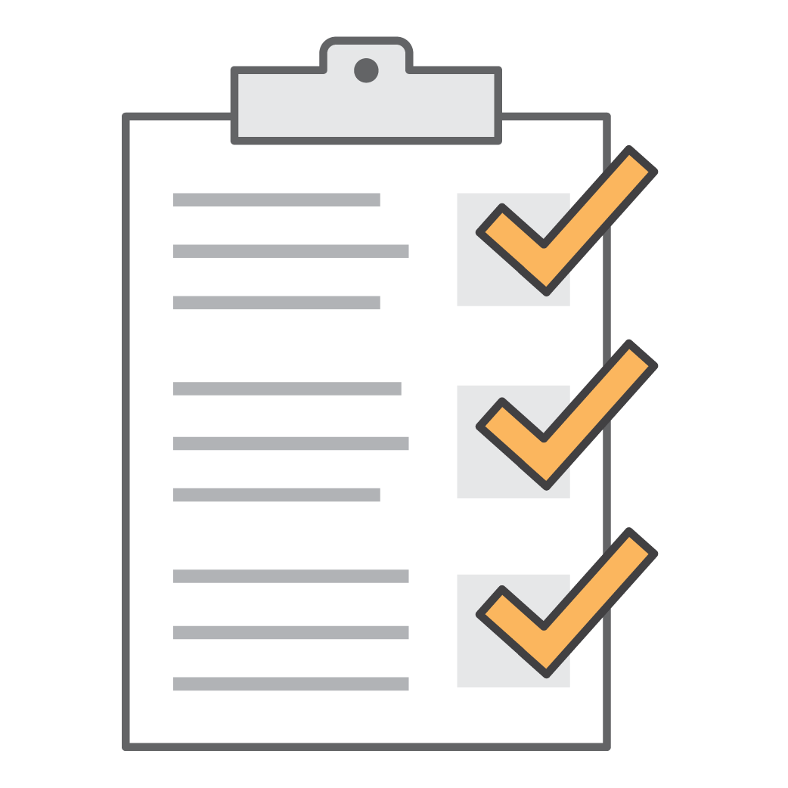


Data Sovereignty and Compliance
Where can you legally host your infrastructure?
What are the national and local
data security laws?
Is customer data allowed outside of the country?
Can you meet governance requirements?
Did you know?
AWS opened its first carbon-neutral Region in 2011 and now offers five!
Notes:
Your first consideration is understanding where you can legally host your infrastructure. What are the national and local data security laws? Keep in mind that your data will be subject to the laws of the country and locality where it's stored.
Is customer data allowed outside of the country? Some laws dictate that if you're operating your business in their jurisdiction, you can’t store that data anywhere else.
Can you meet governance requirements? Compliance standards—such as the United States’ Health Insurance Portability and Accountability Act, or HIPAA—have strict guidelines on how and where data can be stored. AWS Architects take all of these considerations into account when they evaluate where to host infrastructures.
Did you know that AWS opened its first carbon-neutral Region in 2011, and we now offer five separate carbon-neutral Regions?
For more information on carbon-neutral options, select the link.
https://aws.amazon.com/about-aws/sustainability

Slide 7
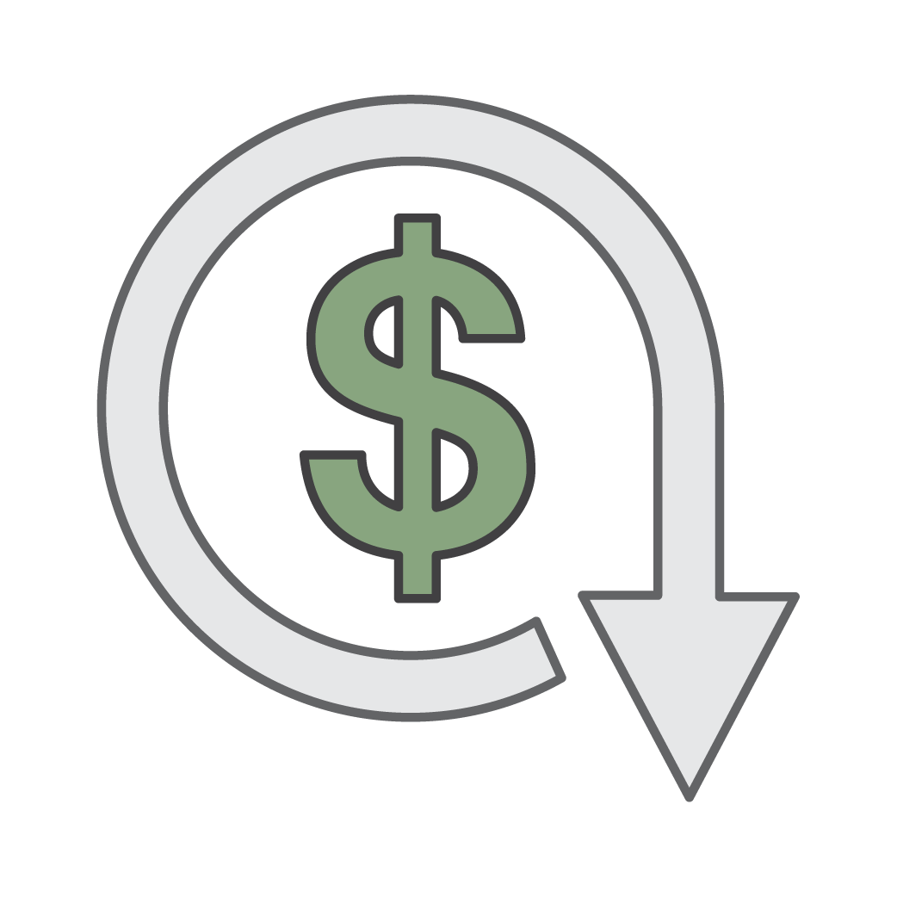
Proximity of Users to Data
What is the proximity to your user base?
$
$$
$$
Study: 100-ms delays can cost 1% in sales on Amazon.com
Equidistant regions? Compare costs
Notes:
A second consideration to look for is proximity to your user base. Proximity is a big factor in choosing your Region, especially when latency is critical. In most cases, the latency difference between using the closest Region and the farthest Region is relatively small, but even small differences in latency can impact a customer experience.
An internal study in 2006 found that every 100 millisecond delay on Amazon.com corresponded to a 1 percent drop in sales. Customers expect responsive environments, and as time goes by and technology becomes more powerful, customers’ expectations rise as well.
If you have two Regions that are equidistant from one another, compare the costs. All AWS services are priced per Region, which means some Regions are more expensive than others.

Slide 8
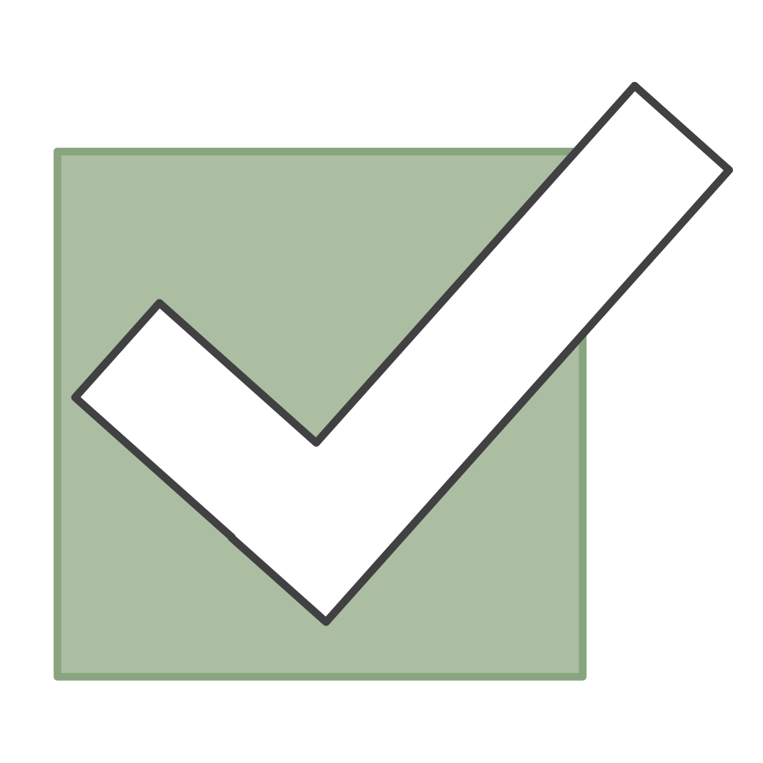
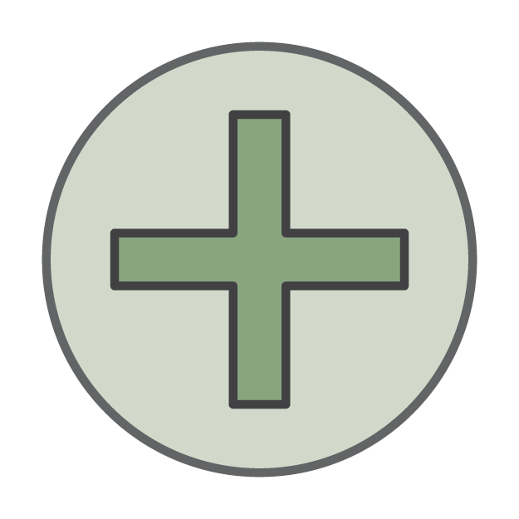
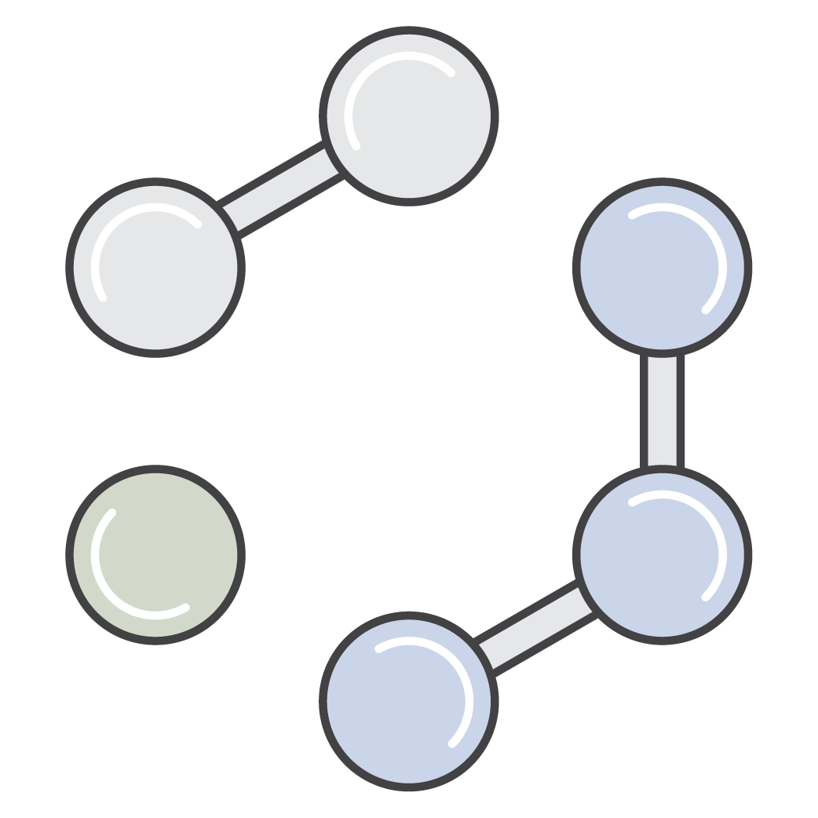
Availability of Services and Features
What services and features are available?
Some services available in limited regions
Some services can cross-regions, but at increased latency
Services expanded to new regions regularly
Notes:
The next consideration should be understanding which services and features are available. Some services are only available in limited regions. While we strive to make all of our services and features available everywhere, the complications that arise from having a global reach make it challenging to accomplish that goal.
Some services can cross Regions, but have increased latency. Services are expanded to new Regions regularly. Rather than waiting until a service is available everywhere before launching it, we release our service when it's ready, and expand its availability as soon as possible. If you’re interested in using a service that’s not available in your Region, you can still explore the possibilities of first going to market with a Region where the service is available. Doing so allows you to embrace a faster "go to market" strategy.

Slide 9
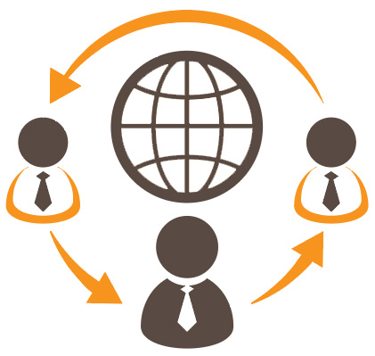
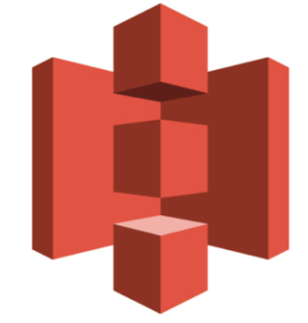
Cost-effectiveness
Consider cost-effectiveness.
Service costs vary by region.
Some services (i.e. Amazon S3) have costs for transferring data out.
Consider replicating entire environment to
another region.
Notes:
Finally, you want to consider cost effectiveness because service costs vary by Region. For example, the cost of running an Amazon Elastic Compute Cloud, or Amazon EC2, instance in the US-East 1 Region might not be the same if you ran it in the EU-West 1 Region. Typically, the difference in cost might not be enough to supersede the other three considerations. However, in cases where the differences in latency, compliance, or service availability between Regions are minimal, you might be able to save money by using the lower-cost Region for your environment.
Some services—such as Amazon Simple Storage Service, or Amazon S3—have costs for transferring data out. If you have Amazon EC2 instances, make sure that they’re in the same Region because you start incurring costs when you transfer data outside of a Region. Keep this in mind when you decide where to place your infrastructure and host your data. The best case for an infrastructure is to use at least two Regions, so if one Region goes down because of a catastrophic event, your infrastructure can still serve your customers. Most applications support this type of setup.
In circumstances where your customers are in different areas of the globe, you might consider optimizing the customer experience by replicating your entire environment to multiple Regions that are closer to your customers. Because you would then be distributing your load across multiple environments, your costs for the components in each environment might go down even as you add more infrastructure. For example, adding a second application environment might allow you to cut your processing and storage capacity requirements in half for each environment. Because AWS is designed to allow you that kind of flexibility, and because you only pay for what you use, you could easily scale your existing environment down as a way to mitigate the cost of adding another environment.
The downside to that approach is that you now have two environments to manage, and not all of your components will scale down enough to mitigate all of the new component costs. Additionally, you might have to maintain one single storage "source of truth" in one Region—such as a master Amazon Relational Database Service, or Amazon RDS, instance. Your secondary Region would have to communicate with the primary Region, which can increase latency and cost for those operations.

Slide 10
Part 2: How Many Availability Zones Should You Use?
Notes:
Once you have determined where you want to host your data, consider how many Availability Zones you should use.

Slide 11
How Many Availability Zones Should You Use?
Recommendation: Start with two Availability Zones per Region.
Best practice: If resources in one Availability Zone are unreachable, your application shouldn't fail.
Most applications can support two Availability Zones.
Something to consider:
For heavy usage (Amazon DynamoDB) it may be beneficial to use more than two Availability Zones.
Notes:
The best recommendation is to start with two Availability Zones per Region.
If resources in one Availability Zone are unreachable, your application shouldn’t fail.
Most applications can be designed to support two Availability Zones, but may not benefit from more, because they use data sources that only support primary and secondary failures.
For heavy Amazon EC2 Spot instance usage or data sources that go beyond active or passive, such as Amazon DynamoDB, there might be a benefit to using more than two Availability Zones. However, using more than two Availability Zones isn’t usually cost-effective.

Slide 12




Using Two Availability Zones
Internet gateway
Elastic load balancer
Public Subnet 1
Web server
Web server
Public Subnet 2
Availability Zone 1
Availability Zone 2
AWS Region
Notes:
This chart shows an example architecture that uses two Availability Zones, an elastic load balancer that distributes traffic between them, and an internet gateway. If one of the web servers becomes unavailable, the load balancer recognizes this change and stops distributing traffic to the unhealthy instance.
This architecture ensures that if there's a problem in one of the Availability Zones where a component resides, your application is still available. Customers shouldn’t experience any differences if a failure occurs.

Slide 13

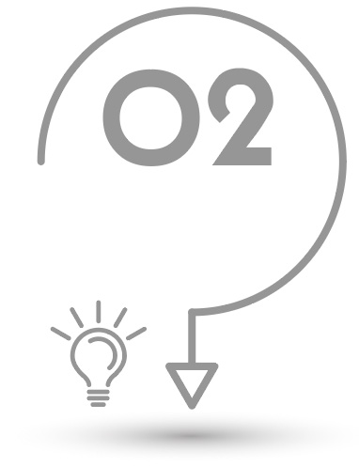
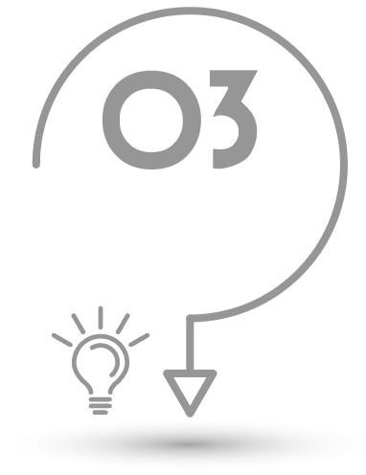
Recommended Availability Zones
How many Availability Zones should be recommended for each scenario?
Applications that heavily use Amazon EC2 Spot Instances
Applications with MySQL, MS SQL Server, Oracle data sources
Applications with data sources Cassandra or MongoDB
2 Availability Zones
(or more based on price options)
2 Availability Zones to support active/passive
2 or more Availability Zones for extremely high availability
Notes:
Let’s review a few scenarios. How many Availability Zones should be recommended for each scenario?
For applications that heavily use Amazon EC2 Spot Instances, two Availability Zones should be recommended, or you can use more for additional price options. Because Amazon EC2 Spot instances are priced according to Availability Zone, you could use two Availability Zones to get the best price, even when prices change.
For applications that have data sources such as MySQL, Microsoft SQL Server, and Oracle, two Availability Zones should be used to support both active and passive.
For applications with data sources such as Cassandra or MongoDB, two or more Availability Zones should be used for extremely high availability.

Slide 14
Part 3: Virtual Private Cloud (VPC)
Notes:
A virtual private cloud (VPC) is a virtual network dedicated to your AWS account. It is logically isolated from other virtual networks in the AWS Cloud. You can launch your AWS resources, such as Amazon EC2 instances, into your VPC. You can specify an IP address range for the VPC, add subnets, associate security groups, and configure route tables. Now, let’s consider if you should fit everything into one Virtual Private Cloud.

Slide 15
Using One VPC
There are limited use cases where one VPC could be appropriate:
High-performance computing environments
Microsoft active directory for identity management
Small, single applications managed by one person or very small team
For most use cases, there are two primary patterns for organizing your infrastructure:
Multi-VPC or Multi-Account
Notes:
There are limited use cases where one Virtual Private Cloud could be appropriate.
High-performance computing environments might work best entirely within a single VPC, as a single VPC environment will have lower latency than one that’s spread across multiple VPCs.
The use of Microsoft Active directory for identity management might best be limited to one VPC for the strongest security measures.
For small, single applications that are managed by one person or a very small team, it might be easiest to use one Virtual Private Cloud.
In most cases, there are two primary patterns for organizing your infrastructure: Multi-VPC or Multi-Account.

Slide 16

Multi-VPC and Multi-Account Patterns
Multi-VPC Pattern
Shared Services
Amazon VPC
Development
Amazon VPC
Test
Amazon VPC
Production
Amazon VPC
Multi-Account Pattern
Shared Services
AWS Account
Development
AWS Account
Test
AWS Account
Production
AWS Account
Notes:
The Multi-VPC pattern has one Region with four different VPCs—shared services, development, test, and production each have their own VPC.
With the Multi-Account pattern, you can have multiple Amazon web services accounts with the same information—such as shared services, development, test and production—instead of having multiple VPCs.

Slide 17
Multi-VPC Pattern
Best suited for:
Single team or organizations, such as Managed Service Providers.
Limited teams make maintaining standards and managing access far easier.
Exception:
Governance and compliance standards may require workload isolation regardless of organizational complexity.
Notes:
The Multi-VPC pattern with one account is easier to maintain for smaller organizations.
Multi-VPC patterns are best suited for a single team or for organizations, such as Managed Service Providers, or MSPs, that maintain full control over the provisioning and management of all resources in each application environment. Limited teams make maintaining standards and managing access far easier.
For example, a single team developing a large e-commerce application might use this pattern when the developers have full access to the development and production environments. Also, this pattern is very common with Managed Service Providers who manage all resources in test and production.
An exception would be governance and compliance standards that might require workload isolation, regardless of organizational complexity.

Slide 18
Multi-Account Pattern
Best suited for:
Larger organizations and organizations with multiple IT teams.
Medium-sized organizations that anticipate rapid growth.
Why?
Managing access and standards can be challenging in more complex organizations.
Thoughts to consider:
Where will your team be in five years?
Notes:
Multi-Account patterns are best suited for larger organizations, organizations with multiple IT teams, and medium-sized organizations that anticipate rapid growth.
Why? This is because managing access and standards can be challenging in more complex organizations.
Don't just think about where your team is today, but consider where your team will be in five years. It's easier with larger companies to manage with multiple accounts, versus having everything inside of one account with multiple VPCs.

Slide 19
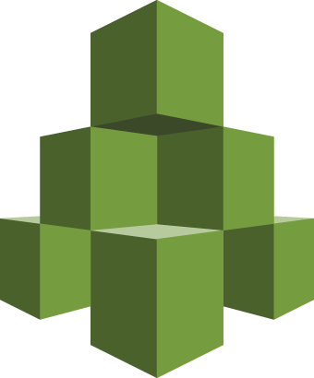
AWS Organizations
Account management service.
Consolidate multiple AWS accounts into an organization and arrange AWS accounts into organizational units.
Consolidated billing and account management capabilities.
AWS Organizations
Notes:
AWS Organizations is an account management service you can use to centrally apply policy-based controls across multiple accounts in the AWS Cloud. You can consolidate all of your AWS accounts into an organization, and arrange all AWS accounts into distinct organizational units.
Organizations includes consolidated billing and account management capabilities that enable you to better meet the budgetary, security, and compliance needs of your business.

Slide 20
AWS Organizations: Features
Hierarchical grouping of your accounts.
Integration and support for AWS Identity and Access Management (IAM).
Integration with other Amazon web services.
Data replication with eventual consistency.
Caching may improve performance.
Notes:
As an administrator of the master account of an organization, there is a hierarchical grouping of your accounts, so you can restrict which AWS services the users and roles in each member account can access. This restriction even overrides the administrators of member accounts in the organization. When Organizations blocks access to a service or action for a member account, a user or role in that account can't access any prohibited service or action, even if an administrator of a member account explicitly grants such permissions in an IAM policy. Organization permissions overrule account permissions.
IAM provides granular control over users and roles in individual accounts. Organizations expands that control to the account level by giving you control over what users and roles in an account or a group of accounts can do. The resulting permissions are the logical intersection of what is allowed by Organizations at the account level, and what permissions are explicitly granted by IAM at the user or role level within that account. In other words, the user can access only what is allowed by both Organizations policies and IAM policies. If either blocks an operation, the user can't access that operation.
Organizations integrate with other Amazon web services. You can enable select Amazon web services to access accounts in your organization and perform actions on the resources in the accounts. When you configure another service and authorize it to integrate with your organization, Organizations creates an IAM service-linked role in each member account. The service-linked role has predefined IAM permissions that allow the other service to perform specific tasks in your organization's accounts. For this service to work, all accounts in an organization have a service-linked role that enables AWS Organizations to create other service-linked roles. These other roles are required by the AWS services that you configure to perform organizational-level tasks. These additional service-linked roles come with policies that enable the specified service to perform only those tasks that are required by your configuration choices.
As a service that is accessed through computers in data centers around the world, AWS Organizations uses a distributed computing model called eventual consistency. Any change that you make in Organizations takes time to become visible from all possible endpoints. Some of the delay results from the time it takes to send the data from server to server, or from replication zone to replication zone. Organizations also uses caching to improve performance, but in some cases this can add time. The change might not be visible until the previously cached data times out.
Design your global applications to account for these potential delays and ensure that they work as expected, even when a change made in one location is not instantly visible at another.

Slide 21
AWS Organizations Key Concepts
Organization
Definitions
Root
Policy
Policy
Policy
Organization
Root
OU
OU
Organization Unit (OU)
AWS
Account
Account
OU
OU
AWS
Account
Invitation
AWS
Account
AWS
Account
Handshake
AWS
Account
AWS
Account
AWS
Account
Service Control Policy
Notes:
The diagram displayed in the slide shows a basic organization that consists of seven accounts, which are organized into four organizational units, or OUs, under the root. The organization also has several policies that are attached to some of the OUs, or directly attached to accounts.
Let’s review the definitions for each of these items.
An organization is an entity that you create to consolidate your AWS accounts. You can use the AWS Organizations console to centrally view and manage all of your accounts within your organization. An organization has one master account along with zero or more member accounts. You can organize the accounts in a hierarchical, tree-like structure with a root at the top and organizational units nested under the root. Each account can be located directly in the root, or placed in one of the OUs in the hierarchy. An organization has the functionality that is determined by the feature set that you enable.
The root is the parent container for all the accounts for your organization. If you apply a policy to the root, it applies to all the organizational unit and accounts in the organization.
An organization unit (or OU) is a container for accounts within a root. An OU also can contain other OUs, which enables you to create a hierarchy that resembles an upside-down tree. This hierarchy has a root at the top, and the branches of OUs reach down, which end in accounts that are like the leaves of the tree. When you attach a policy to one of the nodes in the hierarchy, it flows down and affects all the branches (OUs) and leaves (accounts) that are beneath it. An OU can have exactly one parent, and currently each account can be a member of exactly one OU.
An account is a standard AWS account that contains your AWS resources. You can attach a policy to an account and apply controls to only that one account.
An organization has one account that is designed as the master account. This is the account that creates the organization. The rest of the accounts that belong to an organization are called member accounts. From the organization's master account, you can create accounts in the organization, invite other existing accounts to the organization, remove accounts from the organization, manage invitations, and apply policies to entities within the organization, such as roots, OUs, or accounts. An account can be a member of only one organization at a time.
The master account has the responsibilities of a payer account, and it’s responsible for paying all charges that are accrued by the member accounts. If you previously had a Consolidated Billing family of accounts, your accounts were migrated to a new organization in AWS Organizations, and the payer account in your Consolidated Billing family has become the master account in your organization. All linked accounts in the Consolidated Billing family become member accounts in the organization, and continue to be linked to the master account. Your bills continue to reflect the relationship between the payer account and the linked accounts.
An invitation is the process of asking another account to join your organization. An invitation can be issued only by the organization's master account, and it’s extended to either the account ID or email address that is associated with the invited account. After the invited account accepts an invitation, it becomes a member account in the organization. Invitations also can be sent to all current member accounts when the organization needs all members to approve the change from supporting only consolidated billing features to supporting all features in the organization. Invitations work by accounts exchanging handshakes. Although you might not see handshakes when you work in the AWS Organizations console, you must work directly with handshakes if you use the AWS Command Line Interface, or AWS CLI, or AWS Organizations API.
A handshake is a multi-step process of exchanging information between two parties. One of its primary uses in AWS Organizations is to serve as the underlying implementation for invitations. Handshake messages are passed between and responded to by the handshake initiator and the recipient so that it ensures that both parties always know the current status. Handshakes are also used when you change the organization from supporting only consolidated billing features to supporting all features that Organizations offer.
A service control policy, or SCP, is a policy that specifies the services and actions that users and roles can use in the accounts that the SCP affects. SCPs are similar to IAM permission policies except that they don't grant any permissions. Instead, SCPs are filters that allow only the specified services and actions to be used in affected accounts. Even if a user is granted full administrator permissions with an IAM permission policy, any access that is not explicitly allowed or that is explicitly denied by the SCPs that affect that account is blocked. For example, if you assign an SCP that allows only database service access to your "database" account, then any user, group, or role in that account is denied access to any other service's operations. SCPs are available only when you enable all features in your organization. You can attach an SCP to the following entities:
• A root, which affects all accounts in the organization
• An OU, which affects all accounts in that OU and all accounts in any OUs in that OU subtree
• Or an individual account

Slide 22
Other Important Considerations
The majority of AWS services do not actually sit within a VPC.
Network traffic between AWS Regions traverse the AWS global network backbone by default.
Sometimes traffic between regions uses the public internet.
Amazon S3 and DynamoDB offer VPC endpoints (powered by PrivateLink) to connect without traversing the public internet.
Notes:
The majority of AWS services do not actually sit within a VPC. Although Amazon EC2 instances are configured with public IP addresses, network traffic between AWS Regions traverse the AWS global network backbone by default, which typically provides more consistent, lower-latency network connectivity than equivalent internet-based connections. On occasion, some traffic between Regions uses the public internet.
If you use the public internet for to connect to popular services like Amazon S3 or Amazon DynamoDB, you should use a VPC endpoint. You can use a VPC endpoint to privately connect your VPC to supported AWS services and to VPC endpoint services that are powered by PrivateLink without using an internet gateway; network address translation, or NAT, device; VPN connection, or AWS Direct Connect connection. Instances in your VPC do not require public IP addresses to communicate with resources in the service. Traffic between your VPC and the other service does not leave the Amazon network.
To learn more, go to the VPC Networking Components page in the Amazon VPC documentation.
http://docs.aws.amazon.com/AmazonVPC/latest/UserGuide/VPC_Networking.html

Slide 23
Part 4: Divide Your VPC into Subnets
Notes:
Now, let’s understand how to divide your VPC into subnets.

Slide 24
VPCs and IP Addresses
When you create your VPC, you specify its set of IP addresses with CIDR notation.
Classless Inter-Domain Routing (CIDR) notation is a simplified way to show a specific range of IP addresses.
Example: 10.0.0.0/16 = all IP addresses from 10.0.0.0 to 10.0.255.255
How does that work? What does the 16 define?
Notes:
When you create your Virtual Private Cloud, you specify its set of IP addresses with Classless Inter-Domain Routing (or CIDR) notation. CIDR notation is a simplified way to show a specific range of IP addresses.
Displayed is the example: 10.0.0.0/16. This IP gives us all the available IP’s displayed in the range from 10.0.0.0 to 10.0.255.255.
So how does that work and what does the 16 tell us? Let’s review this in more depth as we continue.

Slide 25
IP Addresses and CIDR
Every set of 3 digits in an IP address represents a set of 8 binary values (8 bits).
10 . 0 . 0 . 0
00001010
00000000
00000000
00000000
10 . 0 . 255 . 255
00001010
00000000
11111111
11111111
Notes:
Every set of 3 digits in an IP address represents a set of 8 binary values (or 8 bits).

Slide 26
IP Addresses and CIDR: Part I
The 16 in the CIDR notation example represents how many of those bits are "locked down" and cannot change.
10 . 0 . 0 . 0 /16
00001010
00000000
00000000
00000000
16 bits locked
Notes:
The 16 in the Classless Inter-Domain Routing notation example represents how many of those bits are "locked down" and cannot change. This means that you only have a certain amount of bits left to use as IP addresses.

Slide 27
IP Addresses and CIDR: Part II
The unlocked bits can change between 1 and 0, allowing the full range of possible values.
10 . 0 . 0 . 0 /16
00001010
00000000
00000000
00000000
Notes:
The unlocked bits can change between 1 and 0, allowing the full range of possible values.

Slide 28

CIDR Example: 10.0.0.0/16
10 . 0 . 0 . 0
Lowest possible IP
00001010
00000000
00000000
00000000
10 . 0 . 255 . 255
Highest possible IP
00001010
00000000
11111111
11111111
Notes:
Now we can see the lowest IP address available, all the way up to the highest IP address.

Slide 29
VPCs and IP Addresses
Dedicated Network Bits (CIDR) | Bits available to IPs (Total IPs)
/16 | 65,536
/17 | 32,768
/18 | 16,384
/19 | 8,192
/20 | 4,096
… | …
/28 | 16
Amazon VPCs can use CIDR ranges between /16 and /28.
For every one step a CIDR range increases, the total number of IP addresses is cut in half.
Notes:
Amazon VPCs can use CIDR ranges between /16 and /28.
What this means is that under CIDR, you have bits that are dedicated to your network, and bits that are available to IP addresses. The larger the number under CIDR, the fewer the numbers that are left for use by IP addresses because the CIDR numbers are bits that are locked for the network. It's a tradeoff: a larger number means a smaller the number of IP addresses.
For every one step a CIDR range increases, the total number of IP addresses is cut in half.

Slide 30
What Are Subnets?
Subnets are segments or partitions of a network, divided by CIDR range.
Example:
A VPC with CIDR /22 includes 1,024 total IPs
1024 IPs
Note: In every subnet, the first four and last IP addresses are reserved for AWS use.
10.0.0.0: Network address.
10.0.0.1: Reserved by AWS for the VPC router.
10.0.0.2: Reserved by AWS for mapping to Amazon provided DNS.
10.0.0.3: Reserved by AWS for future use.
10.0.0.255: Network broadcast address.
Notes:
Subnets are segments, or partitions of a network, that are divided by the CIDR range.
This example with a CIDR of /22 means that you will have 1,024 total IP addresses. To create subnets of these IP addresses, they can be divided into four groups of 251. These four groups could be set up as two sets of public IP addresses, and two sets of private IP addresses.
The first four IP addresses and the last IP address in each subnet aren’t available for you to use because they are reserved for Amazon Web Services use, and can’t be assigned to an instance. For example, in a subnet with CIDR block 10.0.0.0 /22, the following five IP addresses are reserved:
• 10.0.0.0 is reserved for the network address.
• 10.0.0.1 is reserved by AWS for the VPC router.
• 10.0.0.2 is reserved by AWS for mapping to the Amazon provided Domain Name System, or DNS.
• 10.0.0.3 is reserved by AWS for future use.
• 10.0.0.255 is the network broadcast address. AWS does support broadcast in a VPC, so therefore this address is reserved.
Note that these five IP addresses are automatically reserved on every network range.

Slide 31
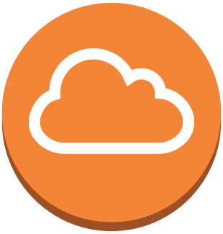

Public and Private Subnets
Internet gateway
Internet gateway
Public subnets
If a subnet’s traffic is routed to an internet gateway, the subnet is a public subnet.
Private subnets
If a subnet’s traffic does not have a route to an internet gateway, the subnet is a private subnet.
Notes:
What is the difference between a public and a private subnet?
If a subnet’s traffic is routed to an internet gateway, the subnet is a public subnet.
If a subnet’s traffic is does not have a route to an internet gateway, the subnet is a private subnet.
For more information on public and private subnets, go to the VPCs and subnets page in the Amazon VPC documentation.
https://docs.aws.amazon.com/vpc/latest/userguide/VPC_Subnets.html

Slide 32
Public and Private Subnets Part II
Recommendation: Use subnets to define internet accessibility.
Public subnets
Include a routing table entry to an internet gateway to support inbound/outbound access to the public internet.
Private subnets
Do not have a routing table entry to an internet gateway and are not directly accessible from the public internet.
Use a "jump box" (NAT/proxy/bastion host) to support restricted, outbound-only public internet access.
Notes:
Subnets should be used to define which parts of the network are accessible to the internet, and which parts are not. Rather than defining your subnets based on application or functional tier—such as web, application, data, etc.—it’s recommended that you organize subnets based on internet accessibility. This practice allows you to define clear, subnet-level isolation between public and private resources.
Public subnets include a routing table entry to an internet gateway to support inbound or outbound access to the public Internet.
Private subnets do not have a routing table entry to an internet gateway, and are not directly accessible from the public internet.
If you have a private subnet that requires internet access—to download security patches for applications, for example—you’d need to use a "jump box" to support the restricted, outbound-only public internet access. A “jump box” is a NAT, proxy, or bastion host.

Slide 33
How to Use Subnets
Recommendation: Use subnets to define Internet accessibility.
Public subnets
Include a routing table entry to an Internet gateway to support inbound/outbound access to the public Internet.
Private subnets
Do not have a routing table entry to an Internet gateway and are not directly accessible from the public Internet.
Typically use a "jump box" (NAT/proxy/bastion host) to support restricted, outbound-only public Internet access.
Notes:
Subnets should be used to define which parts of the network are accessible to the internet, and which parts are not. Rather than defining your subnets based on application or functional tier-such as web, application, data, etc.-it’s recommended that you organize subnets based on internet accessibility. This practice allows you to define clear, subnet-level isolation between public and private resources.
Public subnets include a routing table entry to an internet gateway to support inbound or outbound access to the public Internet.
Private subnets do not have a routing table entry to an internet gateway, and are not directly accessible from the public internet.
If you have a private subnet that requires internet access-to download security patches for applications, for example-you’d need to use a "jump box" to support the restricted, outbound-only public internet access. A “jump box” is a NAT, proxy, or bastion host.

Slide 34
Subnets
10.0.0.0/21 (10.0.0.0-10.0.7.255)
Recommendation: Start with one public and one private subnet per Availability Zone.
10.0.0.0/24
Public subnet
10.0.1.0/24
Public subnet
10.0.2.0/23
Private subnet
10.0.4.0/23
Private subnet
Availability Zone A
Availability Zone B
Notes:
Displayed is an example of how to divide subnets. Subnets should be used to define internet accessibility, so there might not be a good reason to have more than one public and one private subnet per Availability Zone. In this environment, all of your resources that require direct access to the internet-including public-facing load balancers, NAT instances, bastion hosts, etc.-would go into the public subnet, while all other instances would go into your private subnet. An exception would be resources that require absolutely no access to the internet, either directly or indirectly. These resources would go into a separate private subnet.
Some environments try to use subnets to create layers of separation between "tiers" of resources, such as putting your backend application instances and your data resources into separate private subnets. This practice requires you to more accurately predict how many hosts you will need in each subnet, making it more likely that you will either run out of IP addresses more quickly, or leave too many IP addresses unused when they could be used elsewhere.
Subnets can provide a very basic element of segregation between resources by using a network access control list, or network ACL, rules. However, security groups can provide an even more fine-grained level of traffic control between your resources, without the risk of overcomplicating your infrastructure and wasting or running out of IP addresses. With this approach, you just need to anticipate how many public and how many private IP addresses your VPC needs, and use other resources to create segregation between resources within a subnet.

Slide 35
Subnets: Part II
10.0.0.0/21 (10.0.0.0-10.0.7.255)
Recommendation:
Allocate substantially more IP addresses for private subnets than for public subnets.
10.0.0.0/24
Public subnet
10.0.1.0/24
Public subnet
10.0.2.0/23
Private subnet
10.0.4.0/23
Private subnet
Availability Zone A
Availability Zone B
Notes:
The majority of resources on AWS can be hosted in private subnets, using public subnets for controlled access to and from the internet as necessary. You’ll always need more private IP addresses than public IP addresses because the more resources you expose to the internet, the more vulnerable you become. You can protect your IP resources by placing them in a private subnet.
When you plan your architecture, it's important to try to anticipate how many hosts your VPC might need, and how many of those hosts can be placed in private subnets. The course will discuss strategies for placing public-facing resources in private subnets in more detail.

Slide 36
Subnet Sizes
Recommendation: Consider larger subnets over smaller ones (/24 and larger).
Simplifies workload placement:
Choosing where to place a workload among 10 small subnets is more complicated than with one large subnet.
Less likely to waste or run out of IP addresses:
If your subnet runs out of available IP addresses, you can't add more to that subnet.
Ex.: If you have 251 IP addresses in a subnet that's using only 25, you can't share the unused 226 IP addresses with another subnet that's running out.
Notes:
It’s recommended to consider larger subnets over smaller ones, such as slash 24 and larger. This simplifies your workload placement. Choosing where to place a workload among 10 small subnets is more complicated than choosing where to place the same workload with one large subnet.
You’re less likely to waste or run out of IP addresses. If your subnet runs out of available IP addresses, you can't add more IP addresses to that subnet. For example, if you have 251 IP addresses in a subnet that's using only 25 of them, you can't share the unused 226 IP addresses with another subnet that's running out. Consider where you will be five years down the road because this will save you a lot of time. Choose a larger range of IP ranges, rather than a smaller range.
Note that it’s no longer necessary to limit Address Resolution Protocol, or ARP, broadcast domains because this is solved by the VPC.

Slide 37
Select the Subnet Types
Which subnet type (public or private) should you use for these resources?
Data store instances
Private
Batch processing instances
Private
Backend instances
Private
Web application instances
Public or private*
Notes:
Which subnet type should you use for these resources?
While you can put web-tier instances into a public subnet, we actually recommend that you place your web-tier instances inside of private subnets that are behind a load balancer placed in a public subnet. Some environments require web application instances to be attached to Elastic IP addresses directly, even though you can also attach an Elastic IP address to a load balancer. In those cases, web application instances would need to be in a public subnet. We will talk more about load balancers in a later module.

Slide 38
Part 5: Default VPCs and Default Subnets
Notes:
What are default VPCs and default subnets, and when should you use them?

Slide 39
What is a Default VPC?
Details about default VPCs:
Each Region in your account has a default VPC.
Default CIDR is 172.31.0.0/16.
If you create a VPC-based resource (Amazon EC2, Amazon RDS, Elastic Load Balancing, etc.) but don't specify a custom VPC, it will be placed in your default VPC in that region.
Includes a default subnet, IGW, main route table connecting default subnet to the IGW, default security group, and default NACL.
Configurable the same as other VPCs; e.g., adding more subnets.
Notes:
The following list includes details about default VPCs:
• Each Region in your account has a default VPC.
• The default CIDR range is 172.31.0.0/16.
• If you create a VPC-based resource (such as Amazon EC2, Amazon RDS, Elastic Load Balancing, etc.) but don't specify a custom VPC, it will be placed in your default VPC in that Region. That includes the default internet gateway. This scenario means that the VPC set up as the default has internet-routable traffic, the default security group, and the default network ACLs. In general, this situation is never a good idea because many people know the default CIDR range, and that those ranges are automatically connected to internet gateways by default unless they are disabled.
• Default VPCs includes a default subnet, an internet gateway, a main route table that connects the default subnet to the internet gateway, a default security group, and a default network ACL.
• Default VPCs are configurable like other VPCs. For example, you can add more subnets.

Slide 40
What Is a Default Subnet?
Default subnets in default VPCs:
Created within each Availability Zone for each default VPC.
Public subnet with a CIDR block of /20 (4,096 IP addresses).
You can convert it (and any public subnet) into a private subnet by removing its route to the IGW.
When a new Availability Zone is added to a region, your default VPC in that region gets a subnet placed in the new Availability Zone (unless you've made modifications to that VPC).
Notes:
Default subnets in default VPCs:
• Are created within each Availability Zone for each default VPC.
• Have a public subnet with a CIDR block of /20 (with 4,096 IP addresses). The default subnets are created within each Availability Zone. There is a public subnet with a CIDR block range of /20 with over 4,000 IP addresses.
• Can be converted, like any public subnet, into a private subnet by removing its route to the internet gateway. Using the default subnet and the default VPC is like leaving the router login and password set to admin. Many people might know how to use these default credentials, and it’s not very secure.
• When a new Availability Zone is added to a region, your default VPC in that region gets a subnet placed in the new Availability Zone (unless you've made modifications to that VPC).

Slide 41
Default VPCs and Subnets
Recommendation: Use default VPCs and their subnets only for experimenting in your AWS account.
Default VPCs are a quick start solution.
They provide an easy way to test launching instances of your VPC-based resources, without having to set up a new VPC.
For real-world applications, create your own VPCs and subnets.
You'll have greater control and knowledge of their configurations.
Possible to re-establish default VPC if accidentally deleted.
Notes:
We recommended that you use default VPCs and their subnets only for experimenting in your AWS account.
Default VPCs are a quick start solution. They provide an easy way to test launching instances of your VPC-based resources without having to set up a new VPC.
For real-world applications, create your own VPCs and subnets. You'll have greater control and knowledge of their configurations. It’s possible to re-establish a default VPC if it’s accidentally deleted.

Slide 42
Part 6: Controlling VPC traffic
Route tables, security groups, network ACLs, and internet gateways
Notes:
So, how do you control your VPC traffic? In this next section, we’ll discuss route tables, security groups, network ACLs and internet gateways.

Slide 43
Directing Traffic Between VPC Resources
Main route table
Route tables:
Determine where network traffic is routed
Main (default) and custom route tables
All route tables include a local route entry
The local route entry cannot be deleted
Only one route table per subnet
Best practice: Use custom route tables for each subnet.
10.0.0.0/16
Main route table
Destination | Target
10.0.0.0/16 | local
Notes:
As we have discussed, your Amazon VPC is your own logically isolated part of the AWS Cloud. Every VPC has a default route table.
A route table is a map that tells you how to enter and leave your network. It contains a set of rules, called routes, which are used to determine where network traffic is directed. You can have main route tables, which is the default that’s displayed, and custom route tables. For example, you can use custom route tables if you need infrastructure within your VPC that can connect back to your on-premises environment.
All route tables include a local route entry. When you create a VPC, it automatically has a main route table. Initially, the main route table—and every route table in a VPC —contains only a single route: a local route that enables communication within the VPC. You can’t delete the local route in a route table. When you launch an instance in the VPC, the local route automatically covers that instance. You don't need to add the new instance to a route table. You can create additional custom route tables for your VPC.
Each subnet in your VPC must be associated with a route table, which controls the routing for the subnet. If you don't explicitly associate a subnet with a particular route table, the subnet is implicitly associated with—and uses—the main route table. A subnet can be associated with only one route table at a time, but you can associate multiple subnets with the same route table.
A best practice is to use custom route tables for each subnet, which enables granular routing for destinations.

Slide 44
Securing VPC Traffic with Security Groups
Security groups:
Are stateful applications that act as virtual firewalls controlling inbound and outbound traffic for one or more instances.
Deny all incoming traffic by default and use allow rules that can filter based on network protocols (TCP, UDP, and ICMP protocols).
Use a CIDR block or security group to create layers of security to define access to assets.
If your inbound request is allowed, the outbound response is allowed automatically.
Notes:
Security groups are stateful applications that act as virtual firewalls controlling inbound and outbound traffic for one or more instances.
By default, a security group will deny all incoming traffic. You can use rules to control that traffic that filter based network protocols such as Transmission Control Protocol, or TCP, User Datagram Protocol, or UDP, and Internet Control Message Protocol, or ICMP.
You can also use an entire CIDR block or another security group to create layers of security to define who or what has access to your assets.
This is the first layer of protection around instances.
Because a security group is stateful, if your inbound request is allowed, the outbound response is allowed automatically. For example, if you initiate an HTTP request to your instance from your home computer, and your inbound security group rules allow HTTP traffic, information about the connection including the source IP address and port number) is tracked. The HTTP response from your instance to your home computer is recognized as part of an established connection and allowed through the security group, even if the security group rules restrict outbound HTTP Traffic.
For further information, select the link.
http://docs.aws.amazon.com/AmazonVPC/latest/UserGuide/VPC_Networking.html

Slide 45
Security Groups
Use security groups to control traffic into, out of, and between resources.
app
app
App tier
security group
app
app
data
Data tier
security group
data
Private subnet
Private subnet
Availability Zone A
Availability Zone B
Notes:
Use security groups to control traffic into, out of, and between resources. Displayed is an example of what security groups might look like, that spans two Availability Zones. One is set up for the application tier and a second is set up for the data tier.
In the example, the application and data tiers both exist in the private subnets of this VPC. To provide component isolation, the application servers share one security group, and the Amazon RDS instances share another.

Slide 46
How Security Groups are Configured
By default, all newly created security groups allow all outbound traffic to all destinations.
Modifying the default outbound rule on security groups increases complexity and is not recommended unless required for compliance.
Most organizations create security groups with inbound rules for each functional tier (web/app/data) within an application.
Notes:
By default, all newly created security groups allow all outbound traffic to all destinations. Be careful not to make these security groups too complex. Modifying the default outbound rule on security groups increases complexity, and it’s not recommended unless it’s required for compliance.
Most organizations create security groups with inbound rules for each functional tier— including web, application, and data—within an application.

Slide 47
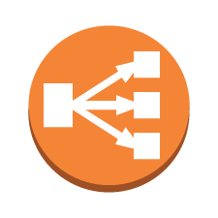
Security Group Chaining Diagram
Inbound Rule
Allow TCP Port 443
Source: 0.0.0.0/0 (Any)
Web tier ELB
security group
Inbound Rule
Allow TCP Port 80
Source: Web tier ELB
Web tier
security group
web
Inbound Rule
Allow TCP Port 8080
Source: Web tier
Security group rules per application tier
App tier ELB
security group
Inbound Rule
Allow TCP Port 8080
Source: App tier ELB
App tier
security group
app
Inbound Rule
Allow TCP Port 3306
Source: App tier
Data tier
security group
data
Notes:
Displayed is an example of a chaining diagram that shows a chain of security groups. The inbound and outbound rules are set up so that traffic can only flow from the top tier to the bottom tier, and back up again. The security groups act as firewalls that prevent a security breach in one tier from automatically providing subnet-wide access to all resources in the compromised client.
This diagram also has a web tier Elastic Load Balancing security group. It’s allowed to talk to the web tier security group over port 80, but that traffic has to come from the web tier elastic load balancer. The traffic can’t come directly from the internet and access the web tier security group and its servers. The third tier is the application tier elastic load balancer. That tier only accepts traffic that comes from the web tier security group over port 8080. The application tier security group servers will only accept traffic that comes from the application tier elastic load balancer group from port 8080. Finally, when you get to the data tier, it will only accept inbound traffic from the application tier over port 3306.
With this kind of security chaining, someone from the internet can’t get beyond the web tier load balancer security group.

Slide 48
Network ACLs
A network ACL is a virtual firewall that controls traffic in and out of a subnet.
Allow all incoming/outgoing traffic by default and use stateless rules to allow or deny traffic.
"Stateless rules" inspect all inbound and outbound traffic and do not keep track of connections.
An allow rule must be explicitly created.
Notes:
A network access control list, or network ACL, is a virtual firewall that controls access to a subnet. Each subnet can have only one network ACL assigned. If you don’t create a network ACL for a subnet, a “default network ACL” will be assigned.
Network ACLs use inbound and outbound rule definitions. Each of these rules either “allow” or “deny” the traffic that’s defined by source, destination, port, and protocol.
You can define multiple rules for both inbound and outbound traffic. Rules are evaluated in numerical order. When you create a network ACL, it’s automatically configured to DENY ALL traffic, and you need to configure the allowed traffic accordingly.
The default network ACL-which is automatically assigned to a subnet when you create it-is configured to ALLOW ALL traffic. We recommended that you evaluate your security requirements and define each network ACL accordingly.
Network ACLs are “stateless.” "Stateless rules" inspect all inbound and outbound traffic, and they don’t keep track of connections. Because they don’t keep track of sessions, when you allow traffic based on an incoming rule, network ACLs don’t automatically allow the corresponding outgoing traffic. An allow rule must be explicitly created.

Slide 49

Directing Traffic to Your VPC
Internet gateways:
Allow communication from internet into VPC.
Are horizontally scaled, redundant, and highly available by default.
Provide a target in your subnet route tables for internet-routable traffic.
users
10.0.0.0/16
Internet gateway
Instance A
with public IP
10.0.10.0/24
Public Subnet
Notes:
Internet gateways allow communication from the internet into your VPC.
They are horizontally scaled out, redundant, and highly available by default. They provide a way for you to get access to the internet, and they allow traffic on the internet to come to you by providing a target in your subnet route tables for internet-routable traffic.
In the example, we have an internet setup connected to a VPC. Because the instance has a public IP address, the internet can access the public instance with the public IP address.

Slide 50
Directing Traffic to Your VPC
To enable access to or from the internet for instances in a VPC subnet, you must:
Attach an internet gateway to your VPC.
Ensure that your subnet's route table points to the internet gateway.
Ensure that instances in your subnet have public IP addresses or Elastic IP addresses.
Ensure that your network ACLs and security groups allow the relevant traffic to flow to and from your instance.
Notes:
If you want to enable access to or from the internet for instances in a VPC subnet, you must:
• Attach an internet gateway to your VPC.
• Ensure that your subnet's route table points to the internet gateway.
• Ensure that instances in your subnet have public IP addresses or Elastic IP addresses.
• And ensure that your network ACLs and security groups allow the relevant traffic to flow to and from your instance.

Slide 51
Outbound Traffic from Private Instances
Network Address Translation services:
Enable instances in the private subnet to initiate outbound traffic to the internet or other AWS services.
Prevent private instances from receiving inbound traffic from the internet.
Two primary options:
Amazon EC2 instance set up as a NAT in a public subnet
NAT Gateway
1
2
Notes:
Network Address Translation, or NAT, services enable instances in the private subnet to initiate outbound traffic to the internet or to other AWS services. NAT services also prevent private instances from receiving inbound traffic from the Internet.
For example, you would use a NAT service if you have a database that you want to keep in the private subnet, but still let it access database patches. The NAT service allows your instance to reach out onto the internet to download patches without letting traffic come back in and access the instance.
AWS offers two primary options for using NAT services:
• An Amazon EC2 instance that’s set up as a NAT service in a public subnet
• And a NAT Gateway

Slide 52

NAT Gateway Service
Users
Users
Destination | Target
10.0.0.0/16 | local
0.0.0.0/0 | NAT
Internet gateway
Internet gateway
10.0.0.0/16
10.0.0.0/16
Destination | Target
10.0.0.0/16 | local
0.0.0.0/0 | NAT
NAT instance
VPC NAT gateway
with public IP
10.0.10.0/24
Public subnet
10.0.10.0/24
Public subnet
Private instance
Private instance
with private IP
Amazon EC2 instance as a NAT in a public subnet
with private IP
10.0.20.0/24
Private subnet
NAT
Gateway
10.0.20.0/24
Private subnet
1
2
Notes:
The example displayed shows the NAT instance, with the private instance on the left. The right side of the diagram shows the VPC NAT gateway. The NAT gateway service is fully scaled, redundant and highly available.
For customers who require a private subnet on their IPv6-enabled VPCs, we are introducing a new resource within the VPC called the Egress-only Internet Gateway, which can be set up to allow one-way access to internet resources. With the Egress-only Internet Gateway, outgoing traffic to the internet will be allowed. However, incoming traffic that’s initiated from the internet will be blocked. There is no additional charge to use the Egress-only Internet Gateways. However, data transfer charges apply.

Slide 53
VPC NAT Gateways vs. NAT Instances on Amazon EC2
 | VPC NAT gateway | NAT instance
Availability | Highly available by default | Use script to manage failover
Bandwidth | Bursts to 10 Gbps | Based on bandwidth of instance type
Maintenance | Managed by AWS | Managed by you
Security | NACLs | Security groups and NACLs
Port forwarding | Not supported | Supported
Scope | Availability Zone | Availability Zone
Notes:
It’s important to carefully consider your decision on which NAT solution you will use, whether it’s a gateway or an instance. While VPC NAT Gateways offer all the advantages of a service that’s managed by AWS—such as being inherently highly available—they might not provide the exact level of control that your application needs.
One example where a NAT gateway might not work as a solution is when you need more than 10GB of bandwidth, which is the maximum amount of bandwidth that the NAT gateway can handle.
Another important difference between the VPC NAT gateway and a NAT instance is port forwarding. The VPC NAT gateway does not support Port 40.
There are also cost differences to consider between the two options.

Slide 54
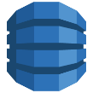
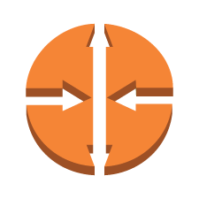
Subnets, Gateways, and Routes
Destination | Target
10.0.0.0/20 | local
0.0.0.0/0 | IGW
Destination | Target
10.0.0.0/20 | local
0.0.0.0/0 | NAT
Internet gateway
10.0.0.0/20
security group
NAT Instance
Private Instance
Private IP
DynamoDB
Public IP
10.0.0.0/24
Public Subnet
10.0.4.0/23
Private subnet
Destination | Target
10.0.0.0/20 | local
0.0.0.0/0 | NAT
Availability Zone 1
Private Instance
Private IP
security group
10.0.2.0/23
Private subnet
route table
Region
Availability Zone 2
Notes:
Let’s look at how subnets, gateways, and routes work together.
This diagram, we have two Availability Zones, two instances and private subnets, the NAT instance with the public IP address, and the public subnet. We also have an internet gateway connected to the VPC.
We have a NAT instance, but it needs a route to the internet gateway so that the instance can talk to the internet. You can see that the internet is in the route table, as indicated by the 0.0.0.0/0 address. The targets that use the internet gateway have the local route group, as indicated by the 10.0.0.0/20 address. If you want the private subnet to be able connect to the internet, it has to go through the NAT instance. The 0.0.0.0 address indicates that it must route to the NAT. The NAT will route the request to the Internet.
The second private instance currently has no route. If that instance needs to go to the internet, a route needs to be created to the NAT instance with the public IP address 0.0.0.0/0 with the target of NAT. This will enable the private instances to access the internet.
You can further tighten security using security groups. There is a security group for the two private instances. There is also a security group for the public NAT group. The security groups and the route tables helps control traffic within the VPC.
The diagram also contains a DynamoDB instance that sits outside of the VPC, but in the same Region as the VPC. Traffic could be routed to it via the internet gateway. Remember that there will be some services that reside outside of your VPC. One of those services is DynamoDB.

Slide 55
How should you monitor your VPC traffic?
Notes:
How should you monitor your VPC traffic?

Slide 56
Amazon VPC Flow Logs
Captures traffic flow details in your VPC
Accepted and rejected traffic
Can be enabled for VPCs, subnets, and ENIs
Logs published to CloudWatch Logs
Use cases:
Troubleshoot connectivity issues.
Test network access rules.
Monitor traffic.
Detect and investigate security incidents.
Notes:
How can you verify that the configured network access rules are working as expected? Many organizations typically collect, store, monitor, and analyze network flow logs for various purposes, including troubleshooting connectivity and security issues, and testing network access rules.
VPC Flow Logs is a feature that enables you to capture information about the IP traffic that goes to and from network interfaces in your VPC. The flow log captures accepted and rejected traffic flow information for all network interfaces in the selected resource. The information that’s captured by the flow logs can help you with a number of tasks. For example, you can troubleshoot why specific traffic is not reaching an instance, which in turn can help you diagnose overly restrictive security group rules. You can also use flow logs as a security tool to monitor the traffic that is reaching your instance. You can create alarms to notify you if certain types of traffic are detected, and you can also create metrics to help you to identify trends and patterns.
You can create a flow log for a VPC, a subnet, or a network interface. If you create a flow log for a subnet or VPC, each network interface in the VPC or subnet is monitored. Flow log data is published to a log group in CloudWatch Logs, and each network interface has a unique log stream. Log streams contain flow log records, which are log events that consist of fields that describe the traffic for that network interface. Amazon CloudWatch and CloudWatch Logs are covered later.
You can analyze the data that’s captured from flow logs with your own applications or with solutions that are available from AWS Marketplace.

Slide 57
Part 7: Can you connect multiple VPCs to each other?
Notes:
Now, let’s discover how to connect multiple VPCs to each other.

Slide 58




VPN Hub And Spoke Architecture
Customer gateway
One per VPN tunnel
One public IP address per customer gateway
AWS provides two tunnel destinations per Region
Corporate data center
Public-facing applications
Internal company app 1
Internal company app 2
Internal company app 3
Internal company app 4
AWS Region
Notes:
If multiple VPCs need to connect to the data center, you can see the challenge of using a customer gateway.
There can be one customer gateway per VPN tunnel, and one public IP address per customer gateway. AWS provides two tunnel destinations per Region.
In this situation, you would have to maintain unique IP addresses on your end and on your route. You can have a VPN hub-and-spoke architecture to work around this situation. However, is it really an efficient solution?
With a VPN hub-and-spoke architecture:
There are Amazon EC2 VPN instances to the central customer gateway.
There are two Amazon EC2-based VPN endpoints in each spoke to support high availability.
There is a central VPC (hub) that contains common services for all application VPCs.
There is a dynamic routing protocol between the spokes and the hub.

Slide 59
Resolution: VPC Peering
To establish a VPC peering connection:
Owner sends a request to create VPC
Owner of peer VPC accepts connection
To enable flow of traffic, add a route
Update security group rules
VPC peering connection is one-to-one relationship between two VPCs
Amazon EC2 now allows peering relationships between VPCs.
A
C
10.0.0.0/16
10.10.0.0/16
B
10.1.0.0/16
Notes:
In the diagram, VPCs A and B are peered, which does not mean that C can talk to A. By default, VPC peering does not allow C to connect to A unless they are explicitly established as peers. Therefore, you control which VPCs can talk to each other.
To establish a VPC peering connection, the owner of the requester VPC—or local VPC—sends a request to the owner of the peer VPC to create the VPC peering connection. The peer VPC can be owned by you or another AWS account, and can’t have a CIDR block that overlaps with the requester VPC’s CIDR block. The owner of the peer VPC has to accept the VPC peering connection request to activate the VPC peering connection. To enable the flow of the traffic between the peer VPCs using private IP addresses, add a route to one or more of your VPC’s route tables that points to the IP address range of the peer VPC. The owner of the peer VPC adds a route to one of the VPC’s route tables that points to the IP address range of your VPC. You might also need to update the security group rules that are associated with your instance to ensure that traffic to and from the peer VPC is not restricted.
A VPC peering connection is a one-to-one relationship between two VPCs. You can create multiple VPC peering connections for each VPC that you own, but transitive peering relationships are not supported: you will not have any peering relationship with VPCs that your VPC is not directly peered with. You can create a VPC peering connection between your own VPCs, or with a VPC in another AWS account within a single Region.
Amazon EC2 now allows peering relationships to be established between virtual private clouds, or VPCs, across different Regions. Inter-Region VPC peering allows VPC resources that run in different Regions—like Amazon EC2 instances, Amazon RDS databases, and AWS Lambda functions—to communicate with each other. This inter-Region communication occurs without requiring gateways, VPN connections, or separate network services. Data that’s transferred across inter-Region VPC peering connections is charged at the standard inter-Region data transfer rates.

Slide 60
How Does VPC Peering Work?
There is a limit on the number of active and pending VPC peering connections
VPC peering does not support transitive peering relationships.
You can’t have more than one VPC peering connection between the same two VPCs at the same time.
MTU across VPC peering connection is 1500 bytes.
Private DNS values can’t be resolved between instances in peered VPCs.
Route Table
Destination | Target
10.1.0.0/16 | local
10.0.0.0/16 | PCX-1
VPC B
Route Table
PCX-1
Destination | Target
10.0.0.0/16 | local
10.1.0.0/16 | PCX-1
10.0.0.0/16
VPC A
VPC Peering
10.1.0.0/16
Notes:
In this example, an entire CIDR block is opened, but you can specify an IP address on the route table.
To create a VPC peering connection with another VPC, you need to be aware of the following limitations and rules:
• There is a limit on the number of active and pending VPC peering connections that you can have per VPC.
• VPC peering does not support transitive peering relationships. In a VPC peering connection, your VPC will not have access to any other VPCs that the peer VPC might be peered with. This includes VPC peering connections that are established entirely within your own AWS account.
• You can’t have more than one VPC peering connection between the same two VPCs at the same time.
• The Maximum Transmission Unit (MTU) across a VPC peering connection is 1500 bytes.
• A placement group can span peered VPCs. However, you will not get full-bisection bandwidth between instances in peered VPCs.
• Unicast reverse path forwarding in VPC peering connections is not supported.
• Private DNS values can’t be resolved between instances in peered VPCs.
Traffic using inter-Region VPC peering always stays on the global AWS backbone, and traffic never traverses the public internet, which reduces threat vectors, such as common exploits and distributed denial of service, or DDOS, attacks.
You can now reference security groups in a peered VPC in both inbound and outbound rules. This functionality is supported cross-account, so the two VPCs can be in different accounts. Support for security group references in a peered VPC simplifies configuration by controlling peering traffic via security group membership instead of CIDR ranges. You can reference security groups from a peered VPC by using the AWS Management Console, the AWS CLI, and through SDKs.

Slide 61
Part 8: Integrating On-Premises Components
Notes:
How do you integrate on-premises components into your environment?

Slide 62
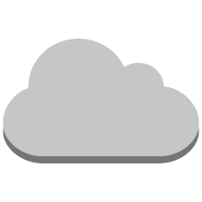

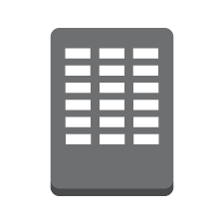
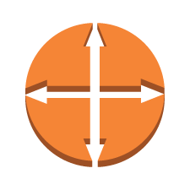
Extending On-Premises Network to AWS: VPN Connections
Two endpoints
Subnet 1
Customer gateway
Availability Zone 1
VGW
VPN connection
Customer Remote Network
Subnet 2
Availability Zone 2
Notes:
One solution is to use a virtual private network, or VPN, connection between your VPC's virtual private gateway, or VGW, and your data center. With an AWS hardware VPN, you are provided with two VPN endpoints to provide basic, automatic failover. To create an AWS hardware VPN, go to the AWS Managed VPN Connections documentation.
http://docs.aws.amazon.com/AmazonVPC/latest/UserGuide/VPC_VPN.html
You can also create a VPN connection to your remote network by using an Amazon EC2 instance in your VPC that's running a software VPN appliance. AWS does not provide or maintain software VPN appliances. However, you can choose one from a range of products that partners and open source communities provide through the AWS Marketplace.

Slide 63
Extending On-Premises Network to AWS: Multiple VPN
Customer gateway
Customer Remote Network
Subnet 1
Availability Zone 1
Customer gateway
VGW
VPN connections
Customer Remote Network
Subnet 2
Customer gateway
Availability Zone 2
Customer Remote Network
Notes:
Amazon Virtual Gateway also supports and encourages multiple customer gateway connections so that customers can implement redundancy and failover on their side of the VPN connection, as shown on this slide. Both dynamic and static routing options are provided to give customers flexibility in their routing configuration. Dynamic routing uses Border Gateway Protocol, or BGP, peering to exchange routing information between AWS and these remote endpoints. Dynamic routing also allows customers to specify routing priorities, policies, and weights or metrics in their BGP advertisements, and to influence the network path between their networks and AWS.
It is important to note that when BGP is used, both the IPSec and the BGP connections must be terminated on the same customer gateway device, so it must be capable of terminating both IPSec and BGP connections.

Slide 64
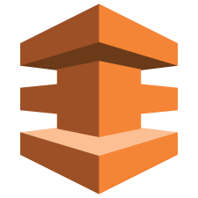
AWS Direct Connect
AWS Direct Connect provides you with a private network connection between AWS and your data center.
It is a network service alternative to using the internet to access AWS Cloud services.
Benefits:
Dedicated, private fiber to AWS.
Create virtual interfaces directly to AWS cloud.
Provides access to AWS in the region it is associated with.
Provision a single connection and use it to access public AWS services in all regions in the U.S.A. and AWS GovCloud (more locations being added).
Notes:
AWS Direct Connect provides you with a private network connection between AWS and your data center.
It is a network service alternative to using the internet to access AWS Cloud services.
AWS Direct Connect links your internal network to an AWS Direct Connect location over a standard 1-gigabit or 10-gigabit Ethernet fiber-optic cable. One end of the cable is connected to your router, and the other is connected to an AWS Direct Connect router. With this connection in place, you can create virtual interfaces directly to AWS cloud (for example, to Amazon Elastic Compute Cloud, or Amazon EC2, Amazon Simple Storage Service, or Amazon S3, and to Amazon Virtual Private Cloud, or Amazon VPC, bypassing Internet service providers in your network path). An AWS Direct Connect location provides access to Amazon Web Services in the region it is associated with, and to other regions in the United States of America. For example, you can provision a single connection to any AWS Direct Connect location in the U.S.A. and use it to access public AWS services in all regions in the U.S.A. and AWS GovCloud.

Slide 65

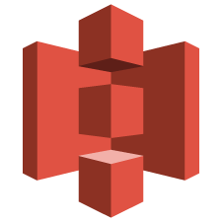
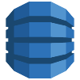



Fundamentals: High-Level View
AWS Account 1
VLAN Y
Public endpoints
public virtual interface (VIF)
VLAN X
Virtual private cloud 1
private VIF 1
Customer Router
VLAN Z
AWS Direct
Connect Router
AWS Account 2
private VIF 2
private VIF N
VLAN N
Virtual private cloud 2
…
Each interface can be associated with a different AWS account (Hosted virtual interfaces).
Direct Connect Location
Virtual private cloud N
Notes:
At a high-level, here are the various ways in which you can connect your on-prem data center to AWS resources via Direct Connect. In this diagram, you can see the connection between connecting public virtual interfaces, or VIFs, to public endpoints and private virtual interfaces to private endpoints.

Slide 66


Single Router, Single Port lus VPN Backup
Public Internet
Customer router
AWS DX
router
Amazon S3
Public VIF
DX Location
Customer internal network
Private VIF
Customer gateway
Instances
Internet
VPN connection
Region
AWS Managed VPN supports up to 1.25 Gbps throughput per VPN tunnel.
Overlapping routes only via propagated routes.
If AWS Direct Connect fails, internet backup for public VIF connections, VPN backup for private VIF connections.
BGP with VPN configuration for faster failover.
Notes:
Let’s look at this in more detail.
Here is a basic diagram of how a single router, and a single port connection to AWS over Direct Connect would route traffic, along with how traffic would flow, in case there's an issue with the Direct Connect connection and a VPN connection is used as a backup.
It is important to understand that AWS Managed VPN supports up to 1.25 Gbps throughput per VPN tunnel and does not support Equal Cost Multi Path (or ECMP) for egress data path in the case of multiple AWS Managed VPN tunnels terminating on the same VGW. Thus, we do not recommend architectures using AWS Managed VPN as a backup for AWS Direct Connect connections with speeds greater than 1 Gbps.

Slide 67
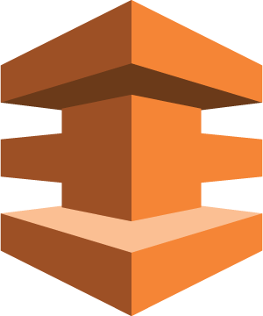
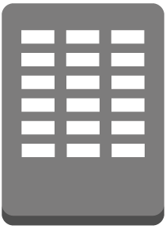
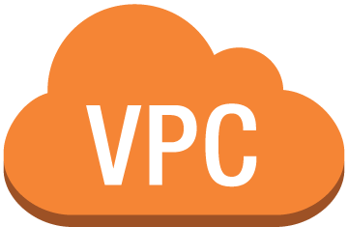
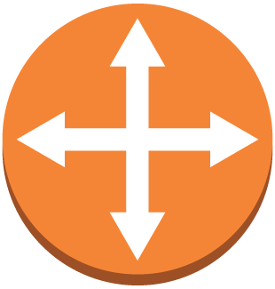
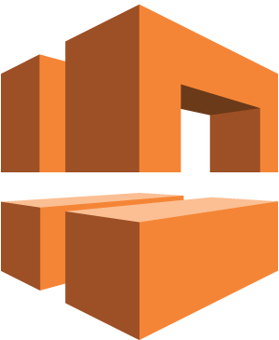

High Resiliency For Critical Workloads
Single Connection Multiple Locations
Virtual Private Gateway
AWS Direct Connect
Location – 1
Customer Data Center 1
10.0.0.0/16
Amazon VPC
172.16.0.0/16
AWS region
AWS Direct Connect
Location – 2
Customer Data Center 2
10.1.0.0/16
Notes:
This configuration consists of AWS Direct Connect connections to separate AWS Direct Connect routers in two locations from two independently configured customer devices. This might be used for critical production workloads that require high resiliency. This would ensure resilience to connectivity failure due to fiber or a device failure as well as a complete location failure.
AWS provides example router configurations to assist in establishing AWS Direct Connect connections and configuring BGP for dynamic routing. In addition to the AWS-provided configuration details, customers must configure VPCs to efficiently route traffic to their data center networks.
AWS Direct Connect supports these port speeds over single-mode fiber: 1 Gbps: 1000BASE-LX (1310nm) and 10 Gbps: 10GBASE-LR (1310nm).
It is important to understand that AWS Managed VPN supports up to 1.25 Gbps throughput per VPN tunnel and does not support Equal Cost Multi Path for egress data path in the case of multiple AWS Managed VPN tunnels terminating on the same VGW.
To learn more about AWS Direct Connect for high resiliency, select the link.
https://aws.amazon.com/directconnect/resiliency-recommendation/

Slide 68
Maximum Resiliency for Critical Workloads
Redundant Active/Active AWS Direct Connect Connections
Virtual Private Gateway
AWS Direct Connect
Location – 1
Customer Data Center 1
10.0.0.0/16
Amazon VPC
172.16.0.0/16
AWS region
AWS Direct Connect
Location – 2
Customer Data Center 2
10.1.0.0/16
Notes:
For maximum resiliency, separate connections terminating on separate devices in more than one location is the recommended architecture. This topology provides resilience to device failure, connectivity failure, and complete location failure.

Slide 69

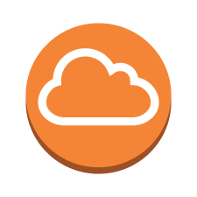


Dual DX – Dual Location
DX Location 1
Colocation
`
`
AWS Direct
Connect Routers
Customer Routers
Service Provider Network
DX Location 2
Colocation
`
`
AWS Direct
Connect Routers
Customer Routers
CORP
Notes:
One further variation in this deployment is dual connections at dual locations with virtual interfaces on each connection. The choice of how much diversity and resilience you choose to deploy depends on your specific resiliency needs.

Slide 70
Part 9: VPC Best Practices
Notes:
Before we finalize this module, let’s review some Virtual Private Cloud best practices.

Slide 71
VPC Considerations and Best Practices
Choose CIDR block or IP address ranges wisely. Plan ahead.
Use subnets to divide resources based on access.
Use Multi-AZ deployments in VPC for high availability.
Use security groups to control traffic between resources.
Use VPC Flow Logs to track and monitor your VPC traffic.
Check the health of your VPN link via API calls or the AWS Management Console.
Notes:
Some best practices include:
• Choosing CIDR block or IP address ranges wisely by selecting a range large enough for future growth (or run multiple VPCs). Start with /16.
• Using subnets to divide resources based on access, which is their primary purpose.
• Using Multi-Availability Zone deployments in a VPC for high availability (you will learn more on that in the next module).
• Using security groups to control traffic between Amazon EC2 instances and elastic load balancers. You can specify a granular security policy for Amazon EC2 instances by using a security group.
• Using VPC Flow Logs to track and monitor VPC traffic. Store traffic logs for a particular VPC, VPC subnet, or Elastic Network Interface to CloudWatch Logs, where they can be accessed by third-party tools for storage and analysis.
• Checking the health of the VPN link via API calls or in the AWS Management Console.

Slide 72
Exercise: Improve This Architecture
Notes:
In this section, we’re going to share an exercise about how to improve the example architecture.

Slide 73
Can You Improve This Architecture?
Internet
gateway
NAT and bastion
Public subnet
Private subnet
Availability Zone 1
Notes:
Using the information that we covered in this module, how can you improve this architecture?

Slide 74
Multi-AZ Deployment with NAT Gateway
Internet
gateway
Public subnet
Public subnet
NAT gateway
NAT gateway
Bastion hosts
Private subnet
Private subnet
Availability Zone A
Availability Zone B
Notes:
In this example, the architecture has been replicated across two Availability Zones. Additionally, a NAT Gateway is being used in place of NAT instances.
Note that NAT gateways are not always more appropriate for your solution than NAT instances on Amazon EC2. Refer to earlier slides to determine which would be right for your environment.
If you have resources in multiple Availability Zones and they share one NAT gateway, if the NAT gateway’s Availability Zone is down, then the resources in the other Availability Zones lose internet access. To create an Availability Zone-independent architecture, create a NAT gateway in each Availability Zone, and configure your routing to ensure that resources use the NAT gateway in the same Availability Zone.

Slide 75
Review
Discussed how to choose a region and an Availability Zone
Examined the how to determine the number of Amazon Virtual Private Clouds (Amazon VPCs) to implement
Gained an understanding about VPCs and Subnets
Identified ways to control VPC Traffic and connect multiple VPCs
Looked at integrating on-premises components
Reviewed default VPCs and subnets
Identified VPC best practices
Exercise: Improve an architecture
To finish this module:
Complete:
Knowledge Assessment
Notes:
In review, we:
• Discussed how to choose a Region and an Availability Zone
• Examined how to determine the number of Amazon Virtual Private Clouds to implement
• Gained an understanding about VPCs and subnets
• Identified ways to control VPC traffic and connect multiple VPCs
• Looked at integrating on-premises components
• Reviewed default VPCs and subnets
• And identified VPC best practices
Finally, we concluded with an exercise to improve an architecture.
To finish this module, please complete the lab and the corresponding knowledge assessment.
75

Slide 76
Up Next: Module 3: Designing for High Availability Section I
Notes:
In the next module, we begin our discussion about how to design for high availability.

Slide 77
Thanks for participating!
© 2018 Amazon Web Services, Inc. or its affiliates. All rights reserved. This work may not be reproduced or redistributed, in whole or in part, without prior written permission from Amazon Web Services, Inc. Commercial copying, lending, or selling is prohibited. Corrections or feedback on the course, please email us at: aws-course-feedback@amazon.com. For all other questions, contact us at: https://aws.amazon.com/contact-us/aws-training/. All trademarks are the property of their owners.
Notes:
Thanks for participating!

